Slide 1
CSDS 451: Designing High Performant Systems for AI
Lecture 9
9/23/2025
Sanmukh Kuppannagari
sanmukh.kuppannagari@case.edu
https://sanmukh.research.st/
Case Western Reserve University

Slide 2
Outline
Accelerating Convolutional Neural Network Models: Basics

Slide 3
Reading Materials
Deep Learning, by Ian Goodfellow, Yoshua Bengio, Aaron Courville
Available Online: https://www.deeplearningbook.org/
CNNs: Chapter 9
A Guide to Convolution Arithmetic for Deep Learning
Available Online: https://arxiv.org/pdf/1603.07285.pdf

Slide 4
Convolutional Neural Networks
Neural Network specialized for a grid-like topology
1D: timeseries data, e.g., (12 pm, 63), (1pm, 65), (2 pm, 68),…
2D: Images
3D: Images with multiple channels, e.g., RGB images
Name derives from “Convolution” operations performed in the “Convolution” Layers

Slide 5
1D Convolution
ya
ax+by
bx+cy
…
$$S$$
$S\left(i\right)=\sum_{m}{I\left(i+m\right)∗K(m)}$
x
y
x
y
x
y
$$K$$
*
*
*
…
a
b
c
d
e
f
$$I$$
Input

Slide 6
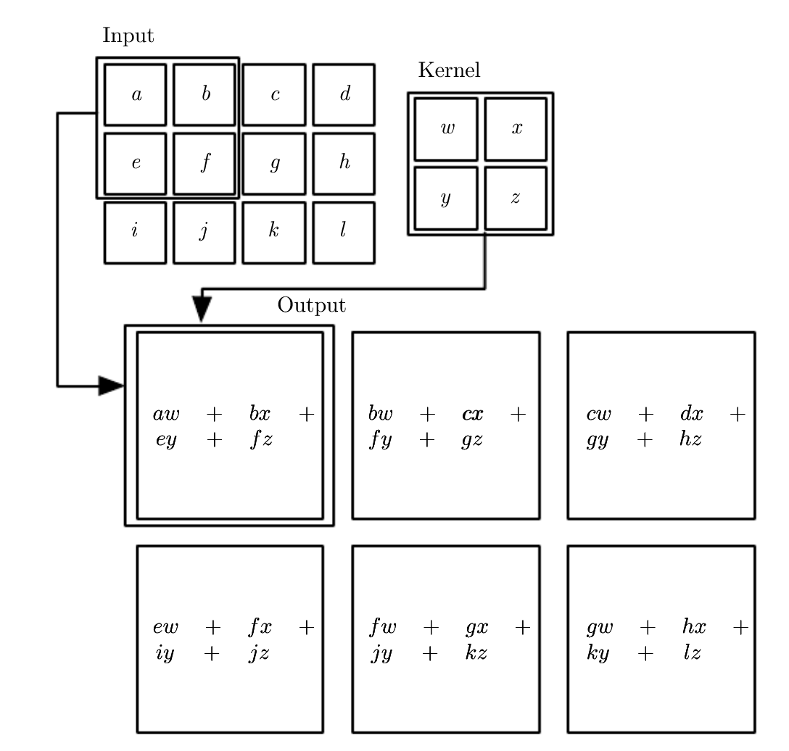
2D Convolution
$$I$$
$$S\left(i,j\right)=\sum_{m}{\sum_{n}{I\left(i+m, j+n\right)K(m,n)}}$$
$$K$$
$$S$$
Source: Deep Learning Book
What happens for corner cases???

Slide 7
Convolutional Neural Network
A Neural Network with:
Convolution Layers
Activations
Pooling Layers
…

Slide 8
Convolution Layer
Given an Input Feature Map
Size: $H×W×C_{in}$
$H:$ Height of the input feature map
$W$: Width of the input feature map
$C_{in}$: Number of Channels in the feature map
$C_{in}×C_{out}$ Kernels, each of size $k×k$
$$H$$
$$W$$
$$C_{in}$$
$$C_{in}$$
$$C_{in}$$
$$k$$
$$C_{out}$$
$$k$$
$$C_{in}$$

Slide 9
Convolution Layer
Produce Output
Size: $H×W×C_{out}$
$$H$$
$$W$$
$$C_{in}$$
$$C_{in}$$
$$C_{in}$$
$$k$$
$$k$$
$$C_{in}$$
$$C_{out}$$
Elementwise summation across channels
$$H$$
$$W$$

Slide 10











Convolution Layer
4
3
Produce Output
Size: $H×W×C_{out}$
2
$$H$$
1
$$W$$
$$C_{in}$$
$$C_{in}$$
3
4
$$C_{in}$$
$$k$$
2
1
$$k$$
$$C_{in}$$
$$C_{out}$$
Elementwise summation across channels
$$H$$
$$W$$

Slide 11
Activation Layer
$$σ$$
$$a$$
$$b$$
$$σ$$
$$σ(a)$$
$$σ(b)$$
$$σ$$
$$c$$
$$d$$
$$σ$$
$$σ(c)$$
$$σ(d)$$
$σ$ : Activation Function, Sigmoid, ReLU, Softmax

Slide 12
Pooling Layer
Replaces the output of a grid with a summary of the grid
a
b
c
Max(a,b,d,e)
Max(b,c,e,f)
d
e
f
Max(d,e,g,h)
Max(e,f,h,i)
g
h
i
Pooling Types:
Average Pooling
Max Pooling
Max Pooling: Size 2 X 2

Slide 13
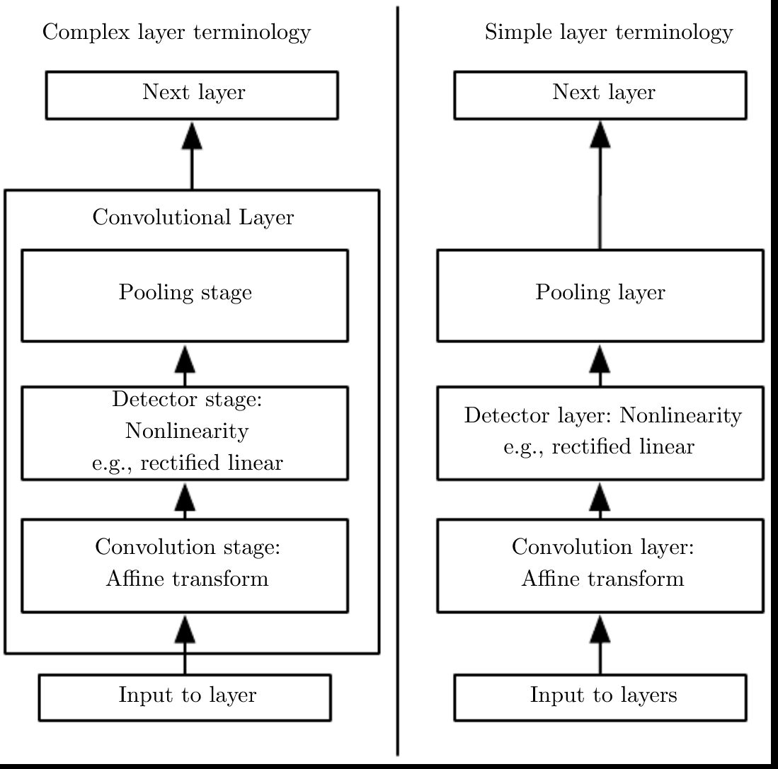
Convolution Neural Network
Source: Deep Learning Book

Slide 14
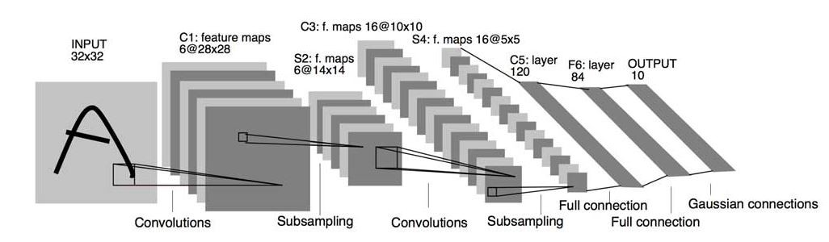
Example CNN Networks
LeNet (1998): Gradient Based Learning Applied to Document Recognitions,
http://yann.lecun.com/exdb/publis/pdf/lecun-01a.pdf

Slide 15
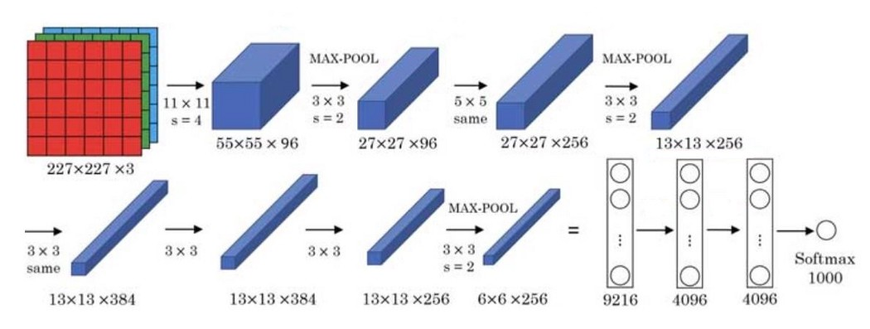
Example CNN Networks
AlexNet (2012): ImageNet Classification with Deep Convolutional Neural Networks,
https://proceedings.neurips.cc/paper/2012/file/c399862d3b9d6b76c8436e924a68c45b-Paper.pdf

Slide 16
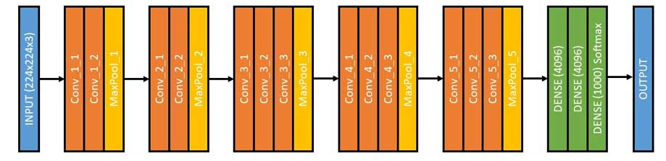
Example CNN Networks
VGG16 (2014): VERY DEEP CONVOLUTIONAL NETWORKS
FOR LARGE-SCALE IMAGE RECOGNITION,
https://arxiv.org/pdf/1409.1556.pdf

Slide 17
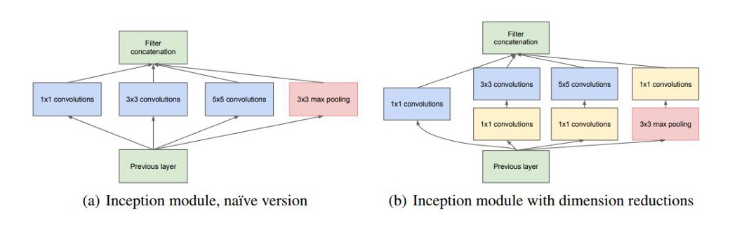
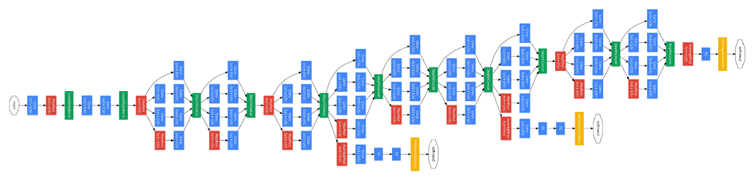
Example CNN Networks
GoogLeNet/InceptionNet (2014): Going deeper with convolutions,
https://arxiv.org/pdf/1409.4842.pdf

Slide 18
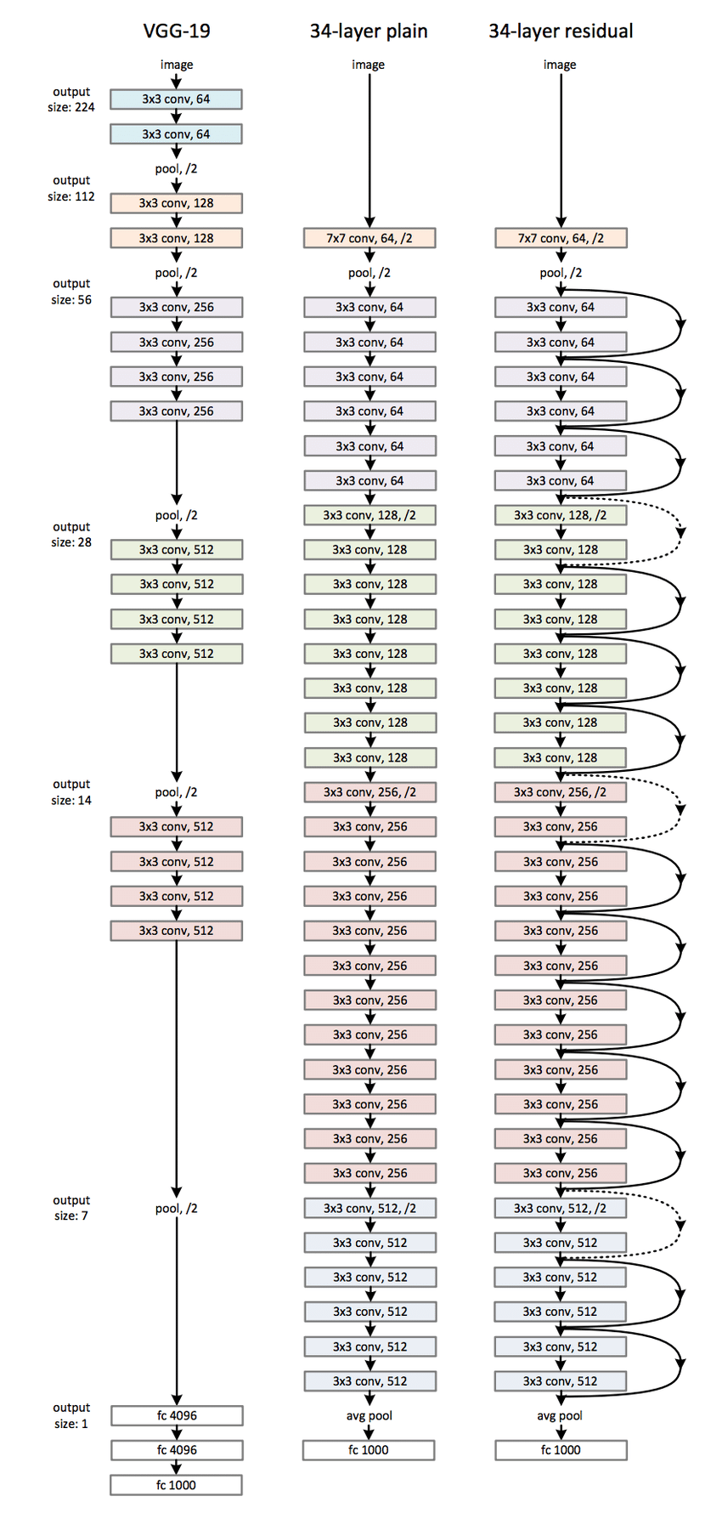
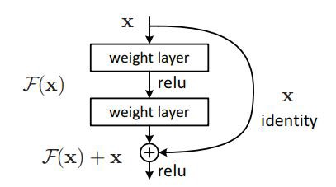
Example CNN Networks
ResNet (2015): Deep Residual Learning for Image Recognition,
https://arxiv.org/pdf/1512.03385.pdf

Slide 19
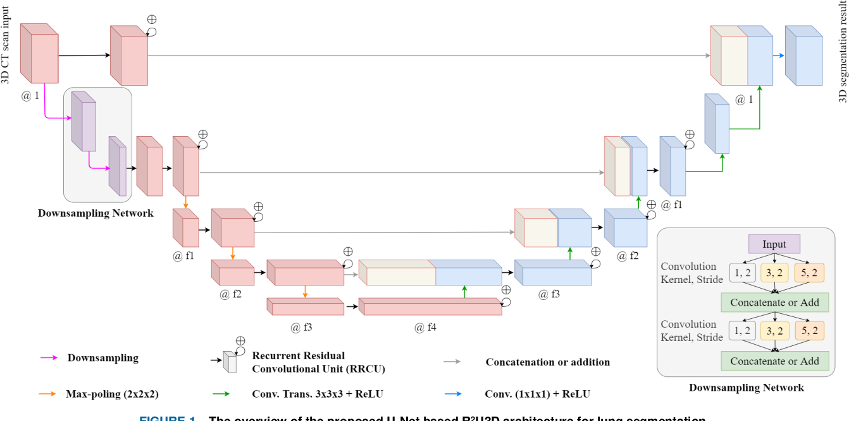
Example CNN Networks
U-net: State of the art in image segmentation, especially in biomedical domain

Slide 20
Example CNN Networks
EfficientNet (2019): Tan, M., & Le, Q. V. (2020). EfficientNet: Rethinking Model Scaling for Convolutional Neural Networks. ArXiv:1905.11946 [Cs, Stat]. http://arxiv.org/abs/1905.11946
FixEfficientNets (2022): Touvron, H., Vedaldi, A., Douze, M., & Jégou, H. (2020b). Fixing the train-test resolution discrepancy: FixEfficientNet. ArXiv:2003.08237 [Cs]. http://arxiv.org/abs/2003.08237
AmoebaNets (2019): Regularized Evolution for Image Classifier Architecture Search, https://ojs.aaai.org/index.php/AAAI/article/view/4405

Slide 21











Performance Modeling of Convolution Layer
Number of Operations: ??
$$H$$
$$W$$
$$C_{in}$$
$$C_{in}$$
$$C_{in}$$
$$k$$
$$k$$
$$C_{in}$$
$$C_{out}$$
Elementwise summation across channels
$$H$$
$$W$$

Slide 22

Performance Modeling of Convolution Layer
Number of Operations:
$H×W×C_{out}×k×k×C_{in}$
$$H$$
$$W$$
$$C_{in}$$
$$C_{in}$$
Output Pixels
Operations per Pixels
$$C_{in}$$
$$k$$
$$k$$
$$C_{in}$$
$$C_{out}$$
Elementwise summation across channels
$$H$$
$$W$$

Slide 23
Performance Modeling of Convolution Layer
Memory Transfers (infinite cache): ??
$$H$$
$$W$$
$$C_{in}$$
$$C_{in}$$
$$C_{in}$$
$$k$$
$$k$$
$$C_{in}$$
$$C_{out}$$
Elementwise summation across channels
$$H$$
$$W$$

Slide 24
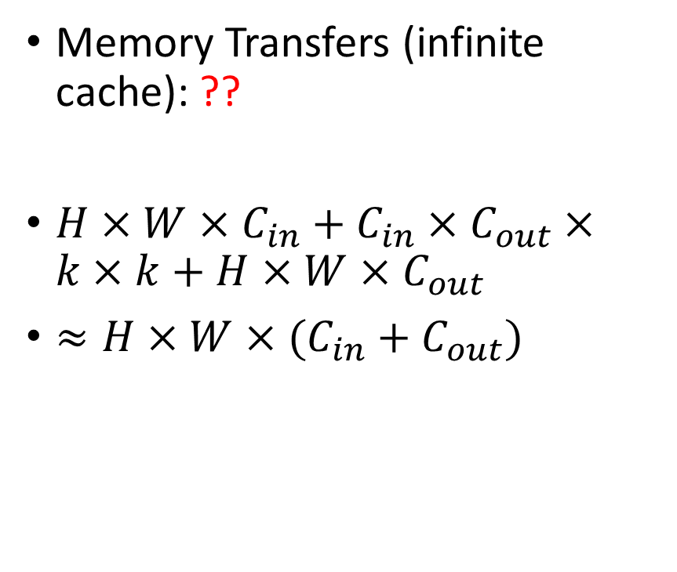
Performance Modeling of Convolution Layer
Memory Transfers (infinite cache): ??
$H×W×C_{in}+C_{in}×C_{out}×k×k+H×W×C_{out}$
$≈H×W×(C_{in}+C_{out})$
$$H$$
$$W$$
$$C_{in}$$
$$C_{in}$$
$$C_{in}$$
$$k$$
$$k$$
$$C_{in}$$
$$C_{out}$$
Elementwise summation across channels
$$H$$
$$W$$

Slide 25
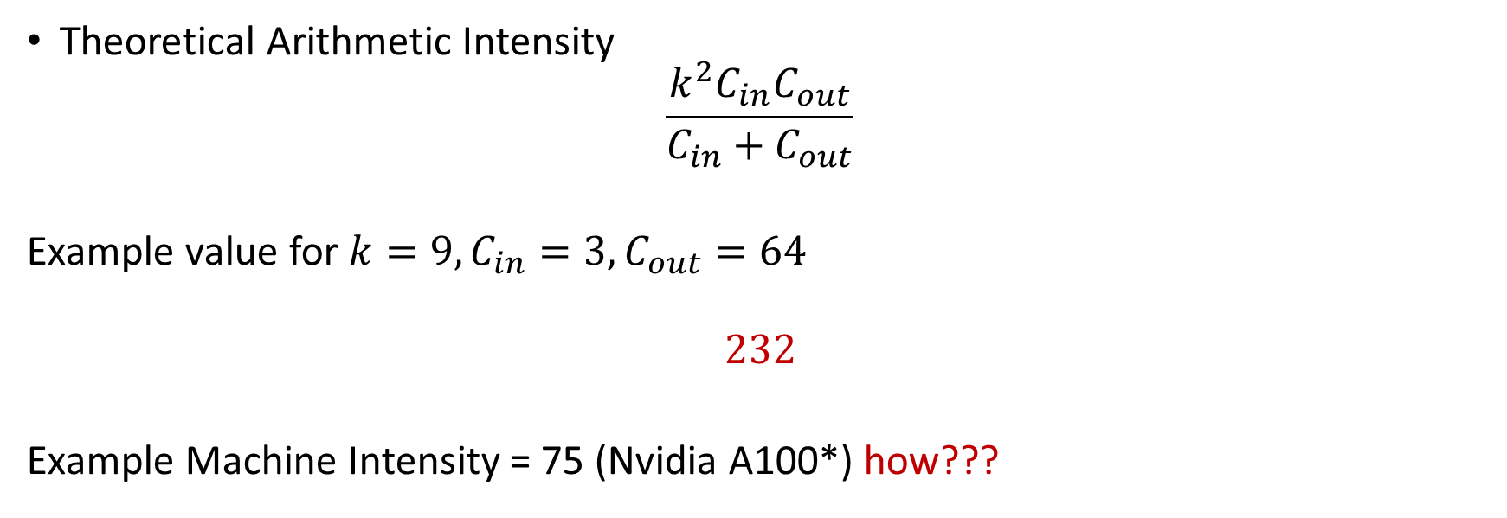
Performance Modeling of Convolution Layer
Theoretical Arithmetic Intensity
$$\frac{k^{2}C_{in}C_{out}}{C_{in}+C_{out}}$$
Example value for $k=9, C_{in}=3, C_{out}=64$
$$232$$
Example Machine Intensity = 75 (Nvidia A100*) how???
*https://www.nvidia.com/content/dam/en-zz/Solutions/Data-Center/a100/pdf/nvidia-a100-datasheet-nvidia-us-2188504-web.pdf

Slide 26
CNN on A100 Roofline Plot (assuming infinite cache)
Memory Bound
Compute Bound
Peak
Performance
Sustained Performance
(ops/sec)
??
Arithmetic Intensity

Slide 27
CNN on A100 Roofline Plot (assuming infinite cache)
Memory Bound
Compute Bound
Peak
Performance
Sustained Performance
(ops/sec)
75
Arithmetic Intensity
Which area will the CNN Performance lie in?

Slide 28
CNN on A100 Roofline Plot (assuming infinite cache)
Memory Bound
Compute Bound
Peak
Performance
Sustained Performance
(ops/sec)
75
Arithmetic Intensity
Which area will the CNN Performance lie in? Compute Bound

Slide 29
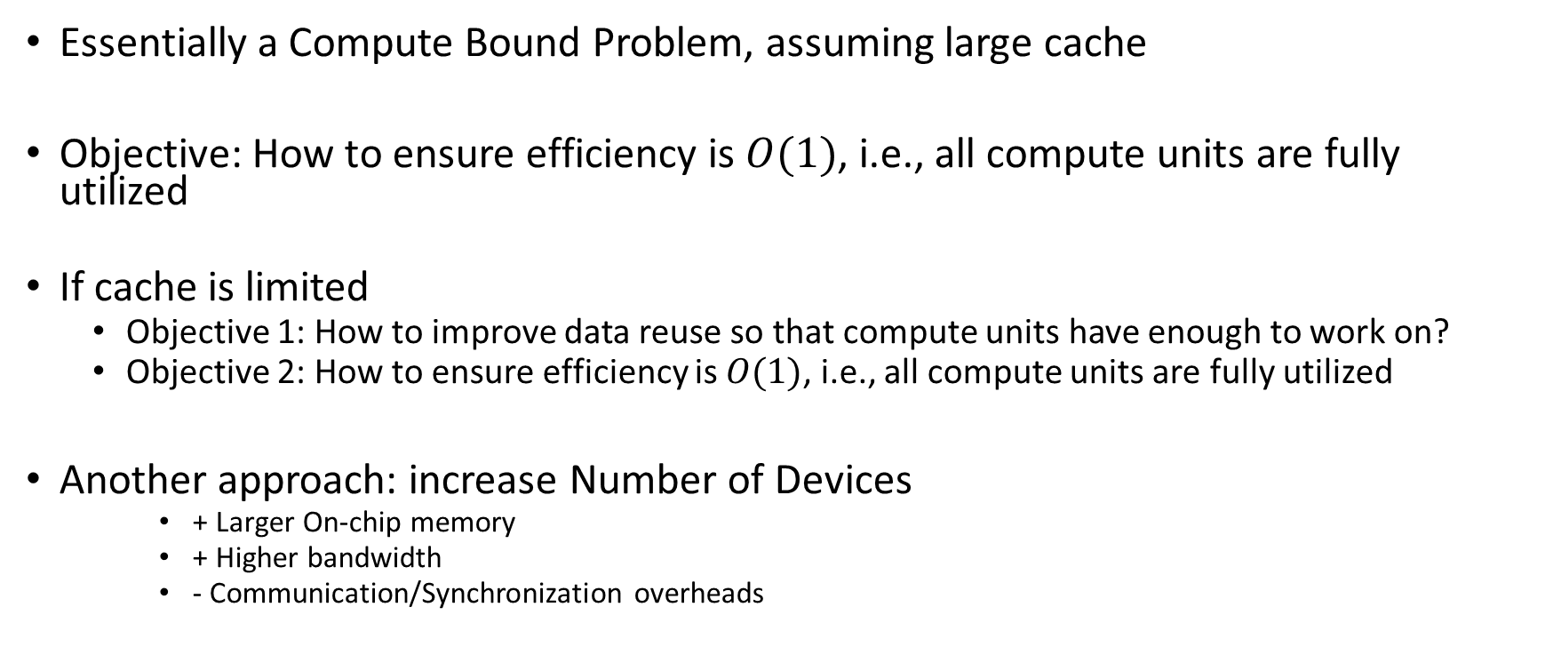
Implications
Essentially a Compute Bound Problem, assuming large cache
Objective: How to ensure efficiency is $O(1)$, i.e., all compute units are fully utilized
If cache is limited
Objective 1: How to improve data reuse so that compute units have enough to work on?
Objective 2: How to ensure efficiency is $O(1)$, i.e., all compute units are fully utilized
Another approach: increase Number of Devices
+ Larger On-chip memory
+ Higher bandwidth
- Communication/Synchronization overheads

Slide 30
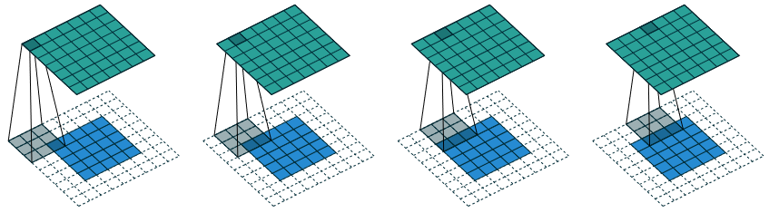
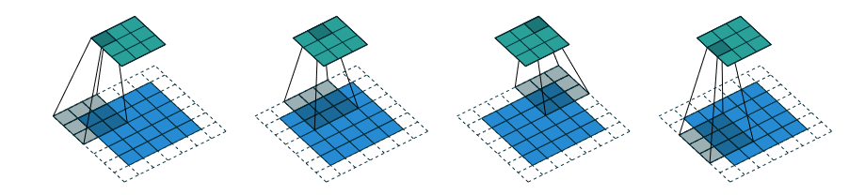
Variations
Reading Homework:
A guide to convolutional arithmetic for deep learning
Padding
Strides

Slide 31
Convolutional Neural Network
Training
Given $x_{i}∈X$ (image from a database), $y_{i}$: Label for the image
“Learn” a model $F$, defined by the filters $W$ such that:
$∑(y_{i} −{F(x}_{i}:W))^2$ is minimized
Inference
Given a new image $x′$
Predict a label $y^{′}=W(x^{′})$
No change in the filters

Slide 32
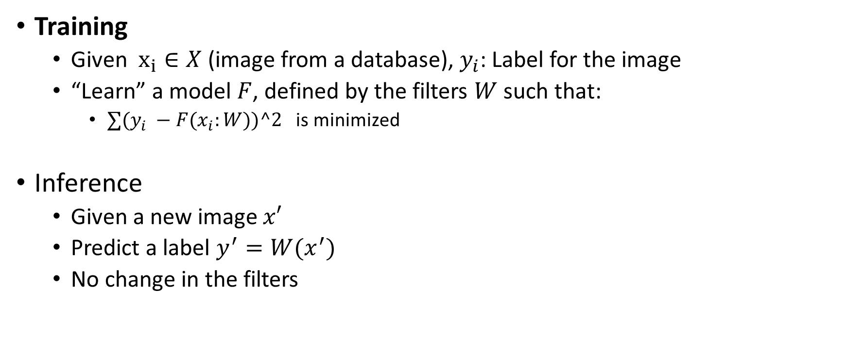
Convolutional Neural Network
Training
Given $x_{i}∈X$ (image from a database), $y_{i}$: Label for the image
“Learn” a model $F$, defined by the filters $W$ such that:
$∑(y_{i} −{F(x}_{i}:W))^2$ is minimized
Inference
Given a new image $x′$
Predict a label $y^{′}=W(x^{′})$
No change in the filters

Slide 33
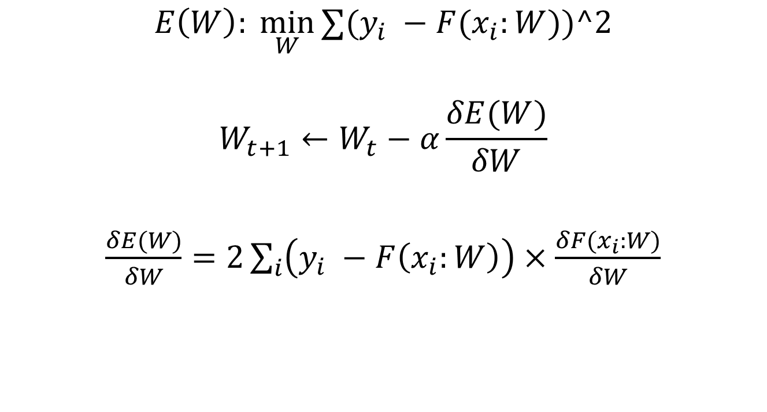
Training
$$E\left(W\right): \min_{W}{∑(y_{i} −{F(x}_{i}:W))^2}$$
$$W_{t+1}←W_{t}−α\frac{δE(W)}{δW}$$
$\frac{δE(W)}{δW}=2\sum_{i}{\left(y_{i} −F\left(x_{i}:W\right)\right)}×\frac{δF(x_{i}:W)}{δW}$
Iteratively
For all samples, in each iteration
Error

Slide 34
Training
$L$ layers in CNN
$$W_{1}, W_{2}, W_{3}, …, W_{L}$$
$$O_{1}, O_{2}, O_{3}, …, O_{L}$$
$$\frac{δF(x_{i}:W_{1:L})}{δW_{1}},\frac{δF(x_{i}:W_{1:L})}{δW_{2}},…,\frac{δF(x_{i}:W_{1:L})}{δW_{L}}$$
Weights (Filters/Kernels)
Output of layer
Compute these for all the samples
$$2∗Error ∗$$

Slide 35

CNN Training: Forward Propagation
$$I$$
For a single image

Slide 36


CNN Training: Forward Propagation
$$I$$
$$W_{1}$$
$$O_{1}$$
For a single image

Slide 37


CNN Training: Forward Propagation
$$I$$
$$W_{1}$$
$$O_{1}$$
$$W_{2}$$
$$O_{2}$$
For a single image

Slide 38


CNN Training: Forward Propagation
$$I$$
$$W_{1}$$
$$O_{1}$$
$$W_{2}$$
$$O_{2}$$
…
$$W_{L}$$
$$O_{L}$$
For a single image

Slide 39


CNN Training: Error Calculation
$$O_{L}$$
$$E(W)$$
$$y$$
For a single image

Slide 40
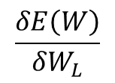
CNN Training: Backward Propagation
$$W_{L}$$
$$O_{L}$$
$$E(W)$$
$$y$$
$$\frac{δE\left(W\right)}{δW_{L}}$$
For a single image

Slide 41
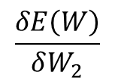
CNN Training: Backward Propagation
$$W_{2}$$
$$O_{2}$$
…
$$W_{L}$$
$$O_{L}$$
$$E(W)$$
$$y$$
$$\frac{δE\left(W\right)}{δW_{2}}$$
$$\frac{δE\left(W\right)}{δW_{L}}$$
For a single image

Slide 42
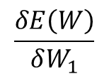
CNN Training: Backward Propagation
$$W_{1}$$
$$O_{1}$$
$$W_{2}$$
$$O_{2}$$
…
$$W_{L}$$
$$O_{L}$$
$$E(W)$$
$$y$$
$$\frac{δE\left(W\right)}{δW_{1}}$$
$$\frac{δE\left(W\right)}{δW_{2}}$$
$$\frac{δE\left(W\right)}{δW_{L}}$$
For a single image

Slide 43
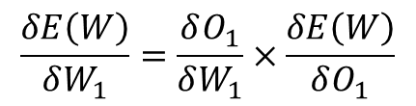
CNN Training: Backward Propagation
$$W_{1}$$
$$O_{1}$$
$$W_{2}$$
$$O_{2}$$
…
$$W_{L}$$
$$O_{L}$$
$$E(W)$$
$$y$$
$$\frac{δE\left(W\right)}{δW_{1}}=\frac{δO_{1}}{δW_{1}}×\frac{δE\left(W\right)}{δO_{1}}$$
For a single image

Slide 44
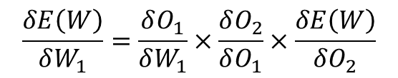
CNN Training: Backward Propagation
$$W_{1}$$
$$O_{1}$$
$$W_{2}$$
$$O_{2}$$
…
$$W_{L}$$
$$O_{L}$$
$$E(W)$$
$$y$$
$$\frac{δE\left(W\right)}{δW_{1}}=\frac{δO_{1}}{δW_{1}}×\frac{δO_{2}}{δO_{1}}×\frac{δE\left(W\right)}{δO_{2}}$$
For a single image

Slide 45
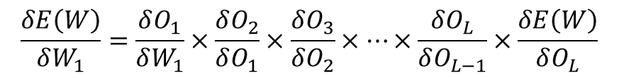
CNN Training: Backward Propagation
$$W_{1}$$
$$O_{1}$$
$$W_{2}$$
$$O_{2}$$
…
$$W_{L}$$
$$O_{L}$$
$$E(W)$$
$$y$$
$$\frac{δE\left(W\right)}{δW_{1}}=\frac{δO_{1}}{δW_{1}}×\frac{δO_{2}}{δO_{1}}×\frac{δO_{3}}{δO_{2}}×…×\frac{δO_{L}}{δO_{L−1}}×\frac{δE\left(W\right)}{δO_{L}}$$
For a single image

Slide 46



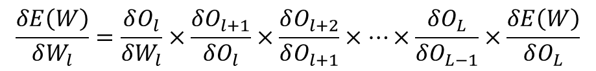

CNN Training: Backward Propagation
$$W_{l}$$
$$O_{l}$$
$$W_{l+1}$$
$$O_{l+1}$$
…
$$W_{L}$$
$$O_{L}$$
$$E(W)$$
$$y$$
$$\frac{δE\left(W\right)}{δW_{l}}=\frac{δO_{l}}{δW_{l}}×\frac{δO_{l+1}}{δO_{l}}×\frac{δO_{l+2}}{δO_{l+1}}×…×\frac{δO_{L}}{δO_{L−1}}×\frac{δE\left(W\right)}{δO_{L}}$$
For a single image

Slide 47
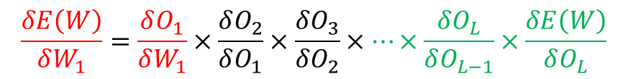
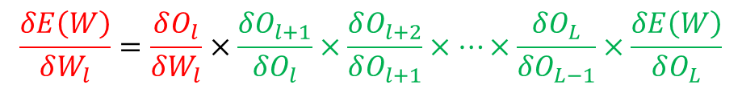
CNN Training: Backward Propagation
$$\frac{δE\left(W\right)}{δW_{1}}=\frac{δO_{1}}{δW_{1}}×\frac{δO_{2}}{δO_{1}}×\frac{δO_{3}}{δO_{2}}×…×\frac{δO_{L}}{δO_{L−1}}×\frac{δE\left(W\right)}{δO_{L}}$$
Reuse calculations performed for later layer
In earlier layer
$$\frac{δE\left(W\right)}{δW_{l}}=\frac{δO_{l}}{δW_{l}}×\frac{δO_{l+1}}{δO_{l}}×\frac{δO_{l+2}}{δO_{l+1}}×…×\frac{δO_{L}}{δO_{L−1}}×\frac{δE\left(W\right)}{δO_{L}}$$

Slide 48
CNN Training: Backward Propagation
2
3
$$W_{l}$$
$$O_{l}$$
$$W_{l+1}$$
$$O_{l+1}$$
…
$$W_{L}$$
$$O_{L}$$
$$E(W)$$
$$y$$
1
2
3
$$\frac{δE\left(W\right)}{δW_{l}}=\frac{δO_{l}}{δW_{l}}×\frac{δO_{l+1}}{δO_{l}}×\frac{δO_{l+2}}{δO_{l+1}}×…×\frac{δO_{L}}{δO_{L−1}}×\frac{δE\left(W\right)}{δO_{L}}$$
1
We need to compute 3 types of terms
For a single image

Slide 49
CNN Training: Backward Propagation
$$W_{l}$$
$$O_{l}$$
$$W_{l+1}$$
$$O_{l+1}$$
…
$$W_{L}$$
$$O_{L}$$
$$E(W)$$
$$y$$
1
$$\frac{δE\left(W\right)}{δW_{l}}=\frac{δO_{l}}{δW_{l}}×\frac{δO_{l+1}}{δO_{l}}×\frac{δO_{l+2}}{δO_{l+1}}×…×\frac{δO_{L}}{δO_{L−1}}×\frac{δE\left(W\right)}{δO_{L}}$$
1
We need to compute 3 types of terms
For a single image

Slide 50

CNN Training: Backward Propagation
$\frac{δE\left(W\right)}{δO_{L}}$ ???

Slide 51

CNN Training: Backward Propagation
$\frac{δE\left(W\right)}{δO_{L}}=\frac{δ}{δO_{L}}{\left(y_{i} −O_{L}\right)}^{2}= ??$

Slide 52

CNN Training: Backward Propagation
$\frac{δE\left(W\right)}{δO_{L}}=\frac{δ}{δO_{L}}{\left(y_{i} −O_{L}\right)}^{2}=−2 ∗Error_{i}$
For $i$ image

Slide 53
CNN Training: Backward Propagation
2
3
$$W_{l}$$
$$O_{l}$$
$$W_{l+1}$$
$$O_{l+1}$$
…
$$W_{L}$$
$$O_{L}$$
$$E(W)$$
$$y$$
2
3
$$\frac{δE\left(W\right)}{δW_{l}}=\frac{δO_{l}}{δW_{l}}×\frac{δO_{l+1}}{δO_{l}}×\frac{δO_{l+2}}{δO_{l+1}}×…×\frac{δO_{L}}{δO_{L−1}}×\frac{δE\left(W\right)}{δO_{L}}$$
We need to compute 3 types of terms
For a single image

Slide 54
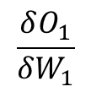
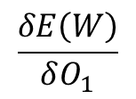
CNN Training: Gradient Calculations
$$\frac{δO_{1}}{δW_{1}}$$
$$\frac{δE\left(W\right)}{δO_{1}}$$
$$W_{1}$$
$$O_{1}$$
$$W_{2}$$
$$O_{2}$$
…
$$W_{L}$$
$$O_{L}$$
$$E(W)$$
$$y$$
$$\frac{δE\left(W\right)}{δW_{1}}=\frac{δO_{1}}{δW_{1}}×\frac{δE\left(W\right)}{δO_{1}}$$

Slide 55












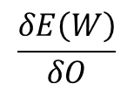







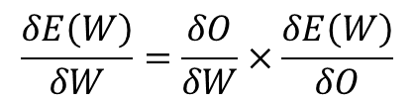












CNN Training: Gradient Calculations
$$\frac{δO}{δW}$$
$$\frac{δE\left(W\right)}{δO}$$
$$I_{1}$$
$$I_{2}$$
$$I_{3}$$
$$I_{4}$$
$$O_{1}$$
$$O_{2}$$
$$O_{3}$$
$$I_{5}$$
$$I_{6}$$
$$I_{7}$$
$$I_{8}$$
$$W_{1}$$
$$W_{2}$$
$$O_{4}$$
$$O_{5}$$
$$O_{6}$$
$$I_{9}$$
$$I_{10}$$
$$I_{11}$$
$$I_{12}$$
$$W_{3}$$
$$W_{4}$$
$$O_{7}$$
$$O_{8}$$
$$O_{9}$$
$$I_{13}$$
$$I_{14}$$
$$I_{15}$$
$$I_{16}$$
Gradients produced till now in backward propagation
$$\frac{δE\left(W\right)}{δW}=\frac{δO}{δW}×\frac{δE\left(W\right)}{δO}$$
For a layer $l,$ removing the subscript $l$ for clarity
Outputs of the previous layer that we produced in Forward Propagation

Slide 56

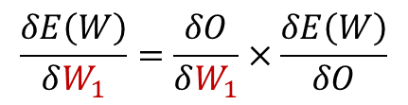
CNN Training: Gradient Calculations
$$\frac{δO}{δW}$$
$$\frac{δE\left(W\right)}{δO}$$
$$I_{1}$$
$$I_{2}$$
$$I_{3}$$
$$I_{4}$$
$$O_{1}$$
$$O_{2}$$
$$O_{3}$$
$$I_{5}$$
$$I_{6}$$
$$I_{7}$$
$$I_{8}$$
$$W_{1}$$
$$W_{2}$$
$$O_{4}$$
$$O_{5}$$
$$O_{6}$$
$$I_{9}$$
$$I_{10}$$
$$I_{11}$$
$$I_{12}$$
$$W_{3}$$
$$W_{4}$$
$$O_{7}$$
$$O_{8}$$
$$O_{9}$$
$$I_{13}$$
$$I_{14}$$
$$I_{15}$$
$$I_{16}$$
$$\frac{δE\left(W\right)}{δW_{1}}=\frac{δO}{δW_{1}}×\frac{δE\left(W\right)}{δO}$$

Slide 57
CNN Training: Gradient Calculations
$$\frac{δO}{δW}$$
$$\frac{δE\left(W\right)}{δO}$$
$$I_{1}$$
$$I_{2}$$
$$I_{3}$$
$$I_{4}$$
$$O_{1}$$
$$O_{2}$$
$$O_{3}$$
$$I_{5}$$
$$I_{6}$$
$$I_{7}$$
$$I_{8}$$
$$W_{1}$$
$$W_{2}$$
$$O_{4}$$
$$O_{5}$$
$$O_{6}$$
$$I_{9}$$
$$I_{10}$$
$$I_{11}$$
$$I_{12}$$
$$W_{3}$$
$$W_{4}$$
$$O_{7}$$
$$O_{8}$$
$$O_{9}$$
$$I_{13}$$
$$I_{14}$$
$$I_{15}$$
$$I_{16}$$
$\frac{δE\left(W\right)}{δW_{1}}=\frac{δO_{1}}{δW_{1}}×\frac{δE\left(W\right)}{δO_{1}}+\frac{δO_{2}}{δW_{1}}×\frac{δE\left(W\right)}{δO_{2}}$ + $\frac{δO_{3}}{δW_{1}}×\frac{δE\left(W\right)}{δO_{3}}$ … + $\frac{δO_{9}}{δW_{1}}×\frac{δE\left(W\right)}{δO_{9}}$

Slide 58
CNN Training: Gradient Calculations
$$\frac{δO}{δW}$$
$$\frac{δE\left(W\right)}{δO}$$
$$I_{1}$$
$$I_{2}$$
$$I_{3}$$
$$I_{4}$$
$$O_{1}$$
$$O_{2}$$
$$O_{3}$$
$$I_{5}$$
$$I_{6}$$
$$I_{7}$$
$$I_{8}$$
$$W_{1}$$
$$W_{2}$$
$$O_{4}$$
$$O_{5}$$
$$O_{6}$$
$$I_{9}$$
$$I_{10}$$
$$I_{11}$$
$$I_{12}$$
$$W_{3}$$
$$W_{4}$$
$$O_{7}$$
$$O_{8}$$
$$O_{9}$$
$$I_{13}$$
$$I_{14}$$
$$I_{15}$$
$$I_{16}$$
$\frac{δE\left(W\right)}{δW_{1}}=\frac{δO_{1}}{δW_{1}}×\frac{δE\left(W\right)}{δO_{1}}+\frac{δO_{2}}{δW_{1}}×\frac{δE\left(W\right)}{δO_{2}}$ + $\frac{δO_{3}}{δW_{1}}×\frac{δE\left(W\right)}{δO_{3}}$ … + $\frac{δO_{9}}{δW_{1}}×\frac{δE\left(W\right)}{δO_{9}}$

Slide 59
CNN Training: Gradient Calculations
$$\frac{δO}{δW}$$
$$\frac{δE\left(W\right)}{δO}$$
$$I_{1}$$
$$I_{2}$$
$$I_{3}$$
$$I_{4}$$
$$O_{1}$$
$$O_{2}$$
$$O_{3}$$
$$I_{5}$$
$$I_{6}$$
$$I_{7}$$
$$I_{8}$$
$$W_{1}$$
$$W_{2}$$
$$O_{4}$$
$$O_{5}$$
$$O_{6}$$
$$I_{9}$$
$$I_{10}$$
$$I_{11}$$
$$I_{12}$$
$$W_{3}$$
$$W_{4}$$
$$O_{7}$$
$$O_{8}$$
$$O_{9}$$
$$I_{13}$$
$$I_{14}$$
$$I_{15}$$
$$I_{16}$$
$\frac{δE\left(W\right)}{δW_{1}}=I_{1}×\frac{δE\left(W\right)}{δO_{1}}+I_{2}×\frac{δE\left(W\right)}{δO_{2}}$ + $I_{3}×\frac{δE\left(W\right)}{δO_{3}}$ … + $I_{11}×\frac{δE\left(W\right)}{δO_{9}}$

Slide 60


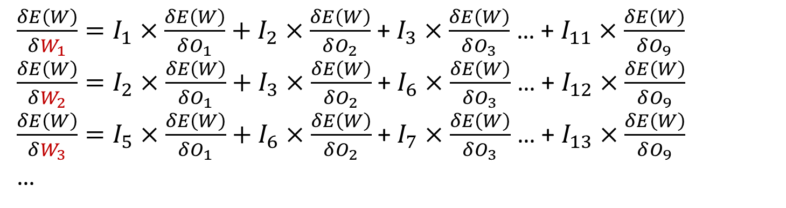

CNN Training: Gradient Calculations
$$\frac{δO}{δW}$$
$$\frac{δE\left(W\right)}{δO}$$
$$I_{1}$$
$$I_{2}$$
$$I_{3}$$
$$I_{4}$$
$$O_{1}$$
$$O_{2}$$
$$O_{3}$$
$$I_{5}$$
$$I_{6}$$
$$I_{7}$$
$$I_{8}$$
$$W_{1}$$
$$W_{2}$$
$$O_{4}$$
$$O_{5}$$
$$O_{6}$$
$$I_{9}$$
$$I_{10}$$
$$I_{11}$$
$$I_{12}$$
$$W_{3}$$
$$W_{4}$$
$$O_{7}$$
$$O_{8}$$
$$O_{9}$$
$$I_{13}$$
$$I_{14}$$
$$I_{15}$$
$$I_{16}$$
$\frac{δE\left(W\right)}{δW_{1}}=I_{1}×\frac{δE\left(W\right)}{δO_{1}}+I_{2}×\frac{δE\left(W\right)}{δO_{2}}$ + $I_{3}×\frac{δE\left(W\right)}{δO_{3}}$ … + $I_{11}×\frac{δE\left(W\right)}{δO_{9}}$
$\frac{δE\left(W\right)}{δW_{2}}=I_{2}×\frac{δE\left(W\right)}{δO_{1}}+I_{3}×\frac{δE\left(W\right)}{δO_{2}}$ + $I_{6}×\frac{δE\left(W\right)}{δO_{3}}$ … + $I_{12}×\frac{δE\left(W\right)}{δO_{9}}$
$\frac{δE\left(W\right)}{δW_{3}}=I_{5}×\frac{δE\left(W\right)}{δO_{1}}+I_{6}×\frac{δE\left(W\right)}{δO_{2}}$ + $I_{7}×\frac{δE\left(W\right)}{δO_{3}}$ … + $I_{13}×\frac{δE\left(W\right)}{δO_{9}}$
…

Slide 61

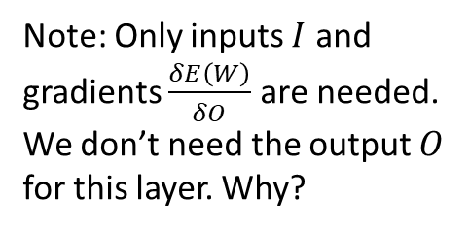


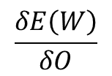






CNN Training: Gradient Calculations
$$\frac{δE\left(W\right)}{δO}$$
$$\frac{δO}{δW}$$
$$I_{1}$$
$$I_{2}$$
$$I_{3}$$
$$I_{4}$$
$$\frac{δE}{δO_{1}}$$
$$\frac{δE}{δO_{2}}$$
$$\frac{δE}{δO_{3}}$$
$$I_{5}$$
$$I_{6}$$
$$I_{7}$$
$$I_{8}$$
$$W_{1}$$
$$W_{2}$$
$$\frac{δE}{δO_{4}}$$
$$\frac{δE}{δO_{5}}$$
$$\frac{δE}{δO_{6}}$$
$$I_{9}$$
$$I_{10}$$
$$I_{11}$$
$$I_{12}$$
$$W_{3}$$
$$W_{4}$$
$$\frac{δE}{δO_{7}}$$
$$\frac{δE}{δO_{8}}$$
$$\frac{δE}{δO_{9}}$$
$$I_{13}$$
$$I_{14}$$
$$I_{15}$$
$$I_{16}$$
Note: Only inputs $I$ and gradients $\frac{δE\left(W\right)}{δO}$ are needed. We don’t need the output $O$ for this layer. Why?
$$\frac{δE\left(W\right)}{δW}=Conv(I,\frac{δE\left(W\right)}{δO} )$$
Note: This operation where the output dimension is greater than input dimension is call deconvolution or transposed convolution

Slide 62
CNN Training: Backward Propagation
3
$$W_{l}$$
$$O_{l}$$
$$W_{l+1}$$
$$O_{l+1}$$
…
$$W_{L}$$
$$O_{L}$$
$$E(W)$$
$$y$$
3
$$\frac{δE\left(W\right)}{δW_{l}}=\frac{δO_{l}}{δW_{l}}×\frac{δO_{l+1}}{δO_{l}}×\frac{δO_{l+2}}{δO_{l+1}}×…×\frac{δO_{L}}{δO_{L−1}}×\frac{δE\left(W\right)}{δO_{L}}$$
We need to compute 3 types of terms
For a single image

Slide 63


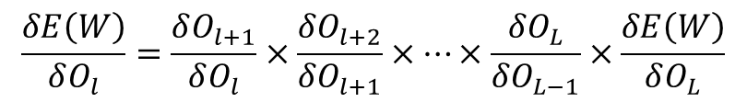
CNN Training: Backward Propagation
$$\frac{δE(W)}{δO_{l+1}}$$
$$\frac{δO_{l+1}}{δO_{l}}$$
$$W_{l}$$
$$O_{l}$$
$$W_{l+1}$$
$$O_{l+1}$$
…
$$W_{L}$$
$$O_{L}$$
$$E(W)$$
$$y$$
$$\frac{δE\left(W\right)}{δO_{l}}=\frac{δO_{l+1}}{δO_{l}}×\frac{δO_{l+2}}{δO_{l+1}}×…×\frac{δO_{L}}{δO_{L−1}}×\frac{δE\left(W\right)}{δO_{L}}$$

Slide 64
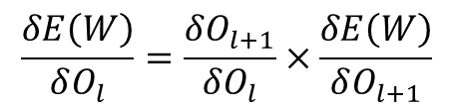
CNN Training: Backward Propagation
$$\frac{δE(W)}{δO_{l+1}}$$
$$\frac{δO_{l+1}}{δO_{l}}$$
$$W_{l}$$
$$O_{l}$$
$$W_{l+1}$$
$$O_{l+1}$$
…
$$W_{L}$$
$$O_{L}$$
$$E(W)$$
$$y$$
$$\frac{δE\left(W\right)}{δO_{l}}=\frac{δO_{l+1}}{δO_{l}}×\frac{δE\left(W\right)}{δO_{l+1}}$$

Slide 65






























CNN Training: Backward Propagation
$$O_{l}$$
$$O_{l+1}$$
$$O_{1}$$
$$O_{2}$$
$$O_{3}$$
$$O_{4}$$
$$\frac{δE}{δO_{1}}$$
$$\frac{δE}{δO_{2}}$$
$$\frac{δE}{δO_{3}}$$
$$O_{5}$$
$$O_{6}$$
$$O_{7}$$
$$O_{8}$$
$$W_{1}$$
$$W_{2}$$
$$\frac{δE}{δO_{4}}$$
$$\frac{δE}{δO_{5}}$$
$$\frac{δE}{δO_{6}}$$
$$O_{9}$$
$$O_{10}$$
$$O_{11}$$
$$O_{12}$$
$$W_{3}$$
$$W_{4}$$
$$\frac{δE}{δO_{7}}$$
$$\frac{δE}{δO_{8}}$$
$$\frac{δE}{δO_{9}}$$
What all do we need for the computation? Do we need inputs or outputs to the layer?
$$O_{13}$$
$$O_{14}$$
$$O_{15}$$
$$O_{16}$$
$$\frac{δE\left(W\right)}{δO_{l}}=Conv(W_{180},\frac{δE\left(W\right)}{δO_{l+1}} )$$
HW: $W_{180} −W$ rotated by 180 degrees

Slide 66
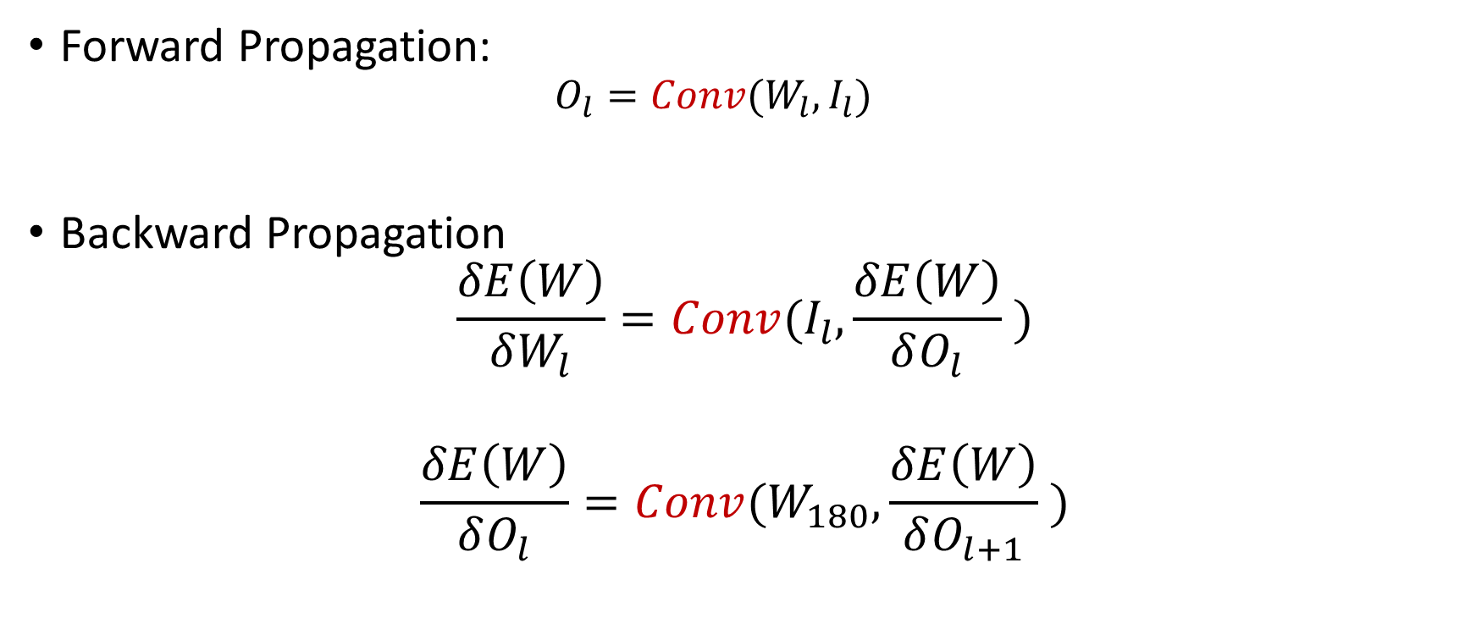
Key Operation in CNN
Forward Propagation:
$$O_{l}=Conv(W_{l}, I_{l})$$
Backward Propagation
$$\frac{δE\left(W\right)}{δW_{l}}=Conv(I_{l},\frac{δE\left(W\right)}{δO_{l}} )$$
$$\frac{δE\left(W\right)}{δO_{l}}=Conv(W_{180},\frac{δE\left(W\right)}{δO_{l+1}} )$$

Slide 67
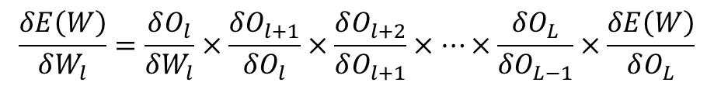
Training
$$E\left(W\right): \min_{W}{∑(y_{i} −{F(x}_{i}:W))^2}$$
$$W_{t+1}←W_{t}−α\frac{δE(W)}{δW}$$
$\frac{δE(W)}{δW}=2∑\left(y_{i} −F\left(x_{i}:W\right)\right)×\frac{δF(x_{i}:W)}{δW}$
Iteratively
For all samples, in each iteration
Error
For multiple images in a batch: Simply sum up the gradients
$$\frac{δE\left(W\right)}{δW_{l}}=\frac{δO_{l}}{δW_{l}}×\frac{δO_{l+1}}{δO_{l}}×\frac{δO_{l+2}}{δO_{l+1}}×…×\frac{δO_{L}}{δO_{L−1}}×\frac{δE\left(W\right)}{δO_{L}}$$

Slide 68
Training
$L$ layers in CNN
$$W_{1}, W_{2}, W_{3}, …, W_{L}$$
$$O_{1}, O_{2}, O_{3}, …, O_{L}$$
$$\frac{δF(x_{i}:W_{1:L})}{δW_{1}},\frac{δF(x_{i}:W_{1:L})}{δW_{2}},…,\frac{δF(x_{i}:W_{1:L})}{δW_{L}}$$
Weights (Filters/Kernels)
Output of layer
$$2∗Error ∗$$

Slide 69
Training – Key Performance Objective
Accuracy – We want to train a model that can predict with low error on unseen data
Throughput – Given a large dataset, we want to train as quickly as possible

Slide 70
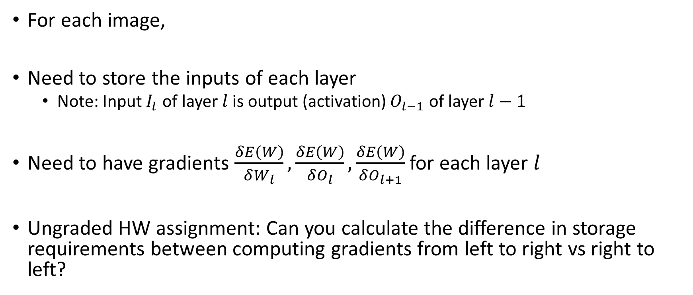
Training – Key Requirement
For each image,
Need to store the inputs of each layer
Note: Input $I_{l}$ of layer $l$ is output (activation) $O_{l−1}$ of layer $l−1$
Need to have gradients $\frac{δE\left(W\right)}{δW_{l}},\frac{δE\left(W\right)}{δO_{l}},\frac{δE\left(W\right)}{δO_{l+1}}$ for each layer $l$
Ungraded HW assignment: Can you calculate the difference in storage requirements between computing gradients from left to right vs right to left?

Slide 71
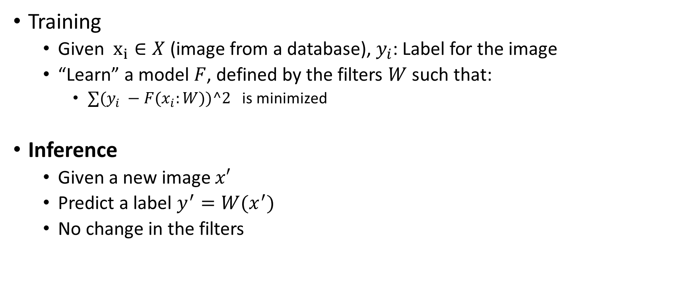
Convolutional Neural Network
Training
Given $x_{i}∈X$ (image from a database), $y_{i}$: Label for the image
“Learn” a model $F$, defined by the filters $W$ such that:
$∑(y_{i} −{F(x}_{i}:W))^2$ is minimized
Inference
Given a new image $x′$
Predict a label $y^{′}=W(x^{′})$
No change in the filters

Slide 72
CNN Training: Forward Propagation
$$I$$
For a single image

Slide 73
CNN Training: Forward Propagation
$$I$$
$$W_{1}$$
$$O_{1}$$
For a single image

Slide 74
CNN Training: Forward Propagation
$$I$$
$$W_{1}$$
$$O_{1}$$
$$W_{2}$$
$$O_{2}$$
For a single image

Slide 75
CNN Training: Forward Propagation
$$I$$
$$W_{1}$$
$$O_{1}$$
$$W_{2}$$
$$O_{2}$$
…
$$W_{L}$$
$$O_{L}$$
For a single image

Slide 76
Inference
Simply the forward propagation portion
No error calculation or backpropagation as ground truth doesn’t exist
Performance Objectives:
Accuracy – Although ground truth is not known
Latency – Perform inference as fast as possible on single or a batch of images

Slide 77
Next Class
9/25 Lecture 10
Accelerating Convolutional Neural Networks: Convolution as Matrix Multiplication

Slide 78
Thank You
Questions?
Email: sanmukh.kuppannagari@case.edu

